Slide 1
Powerful You!
The Museum of Discovery and Science

Slide 2
Group Members
Haerunnisa Dewindita – Java
Ansley White – User Interface
Alexis Alonso – Graphic Designer

Slide 3
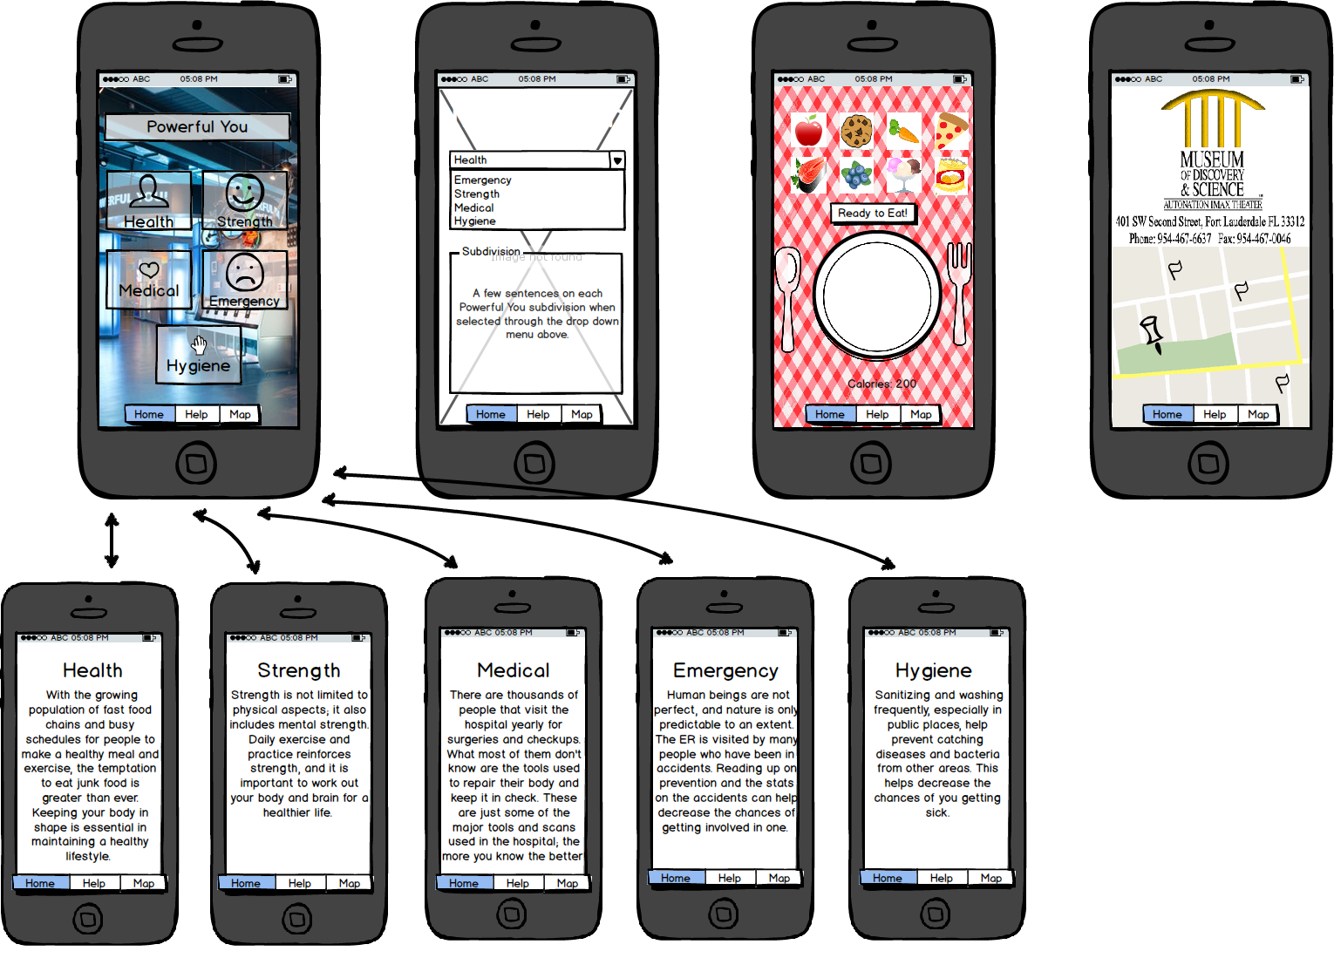
Balsamiq Mockups

Slide 4



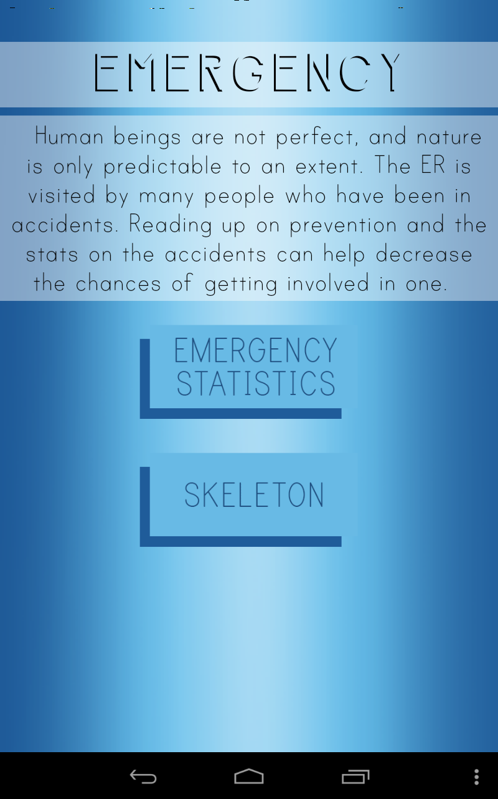
Screen Captures

Slide 5
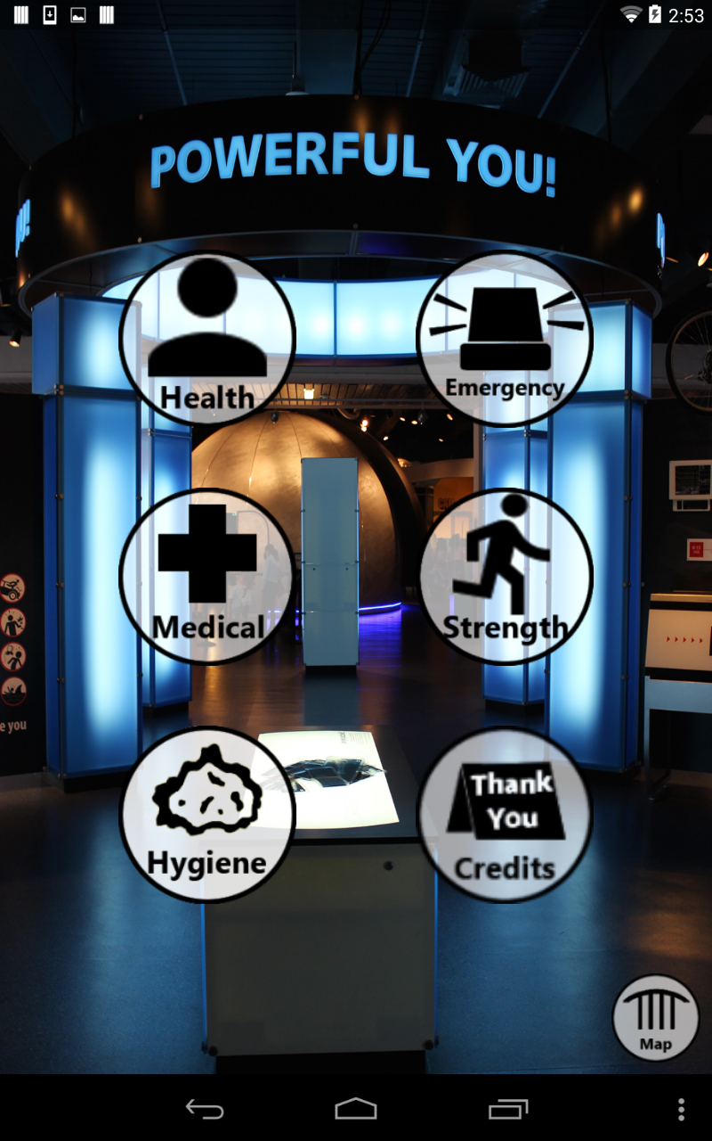
Home Page
Our home page consists of:
Personal captured image of the exhibit
Customized buttons that correspond to each section of the floor plan
Credits and Map button that link to other pages

Slide 6

Health Quiz
Our quiz consists of:
A variety of health related questions that can be figured out or found in the exhibit.
Self Check button for each question to add ease to the process

Slide 7
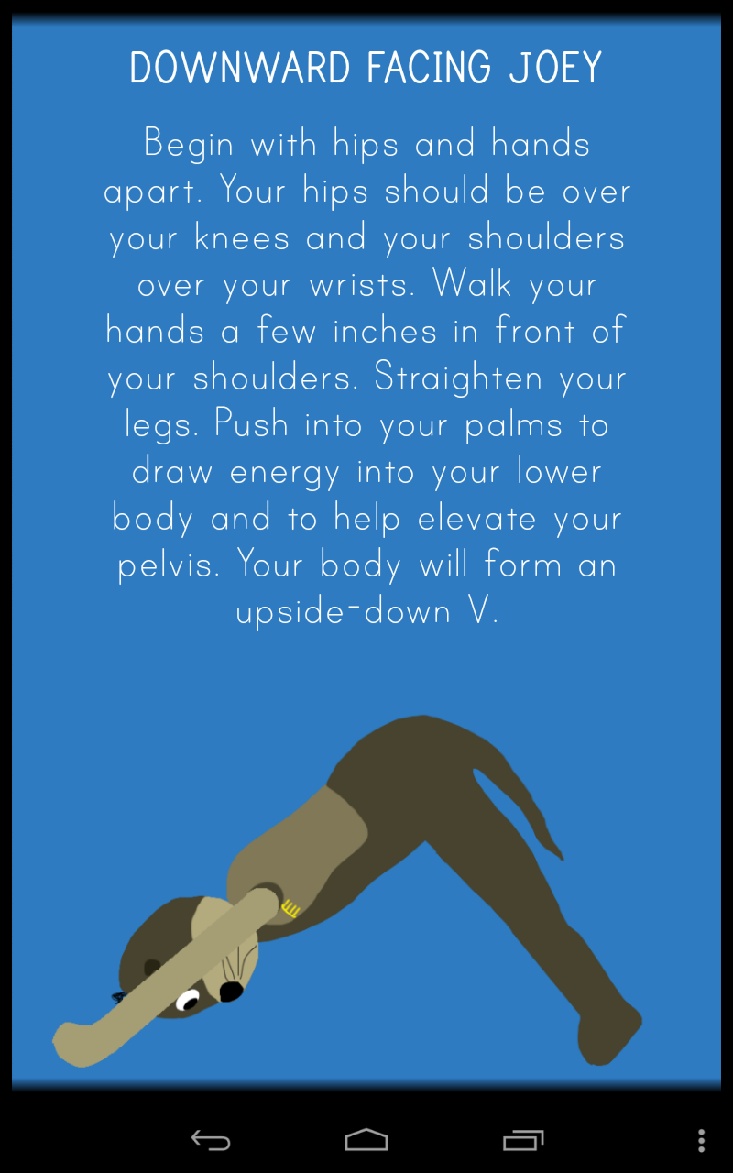
Yoga Poses
Our yoga poses page consists of:
Three simple yoga poses
Names modified to Joey the Otter
Hand drawn graphics of the Joey mascot preforming the poses

Slide 8
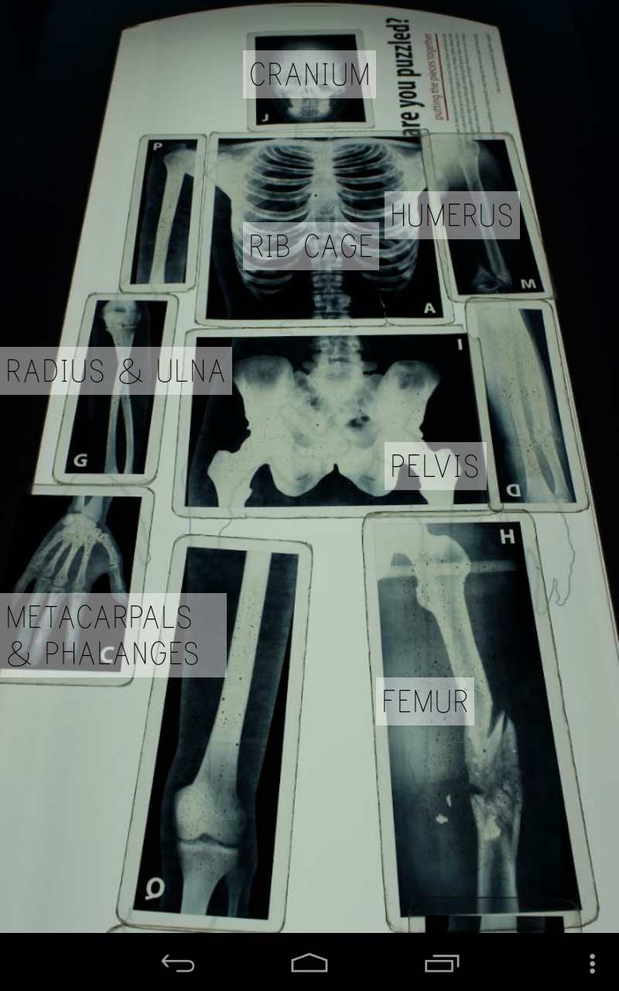
Skeleton
Our skeleton page consists of:
Personally captured image of the skeleton puzzle correctly put together
Text boxes over each button naming the bone it is hovering over

Slide 9
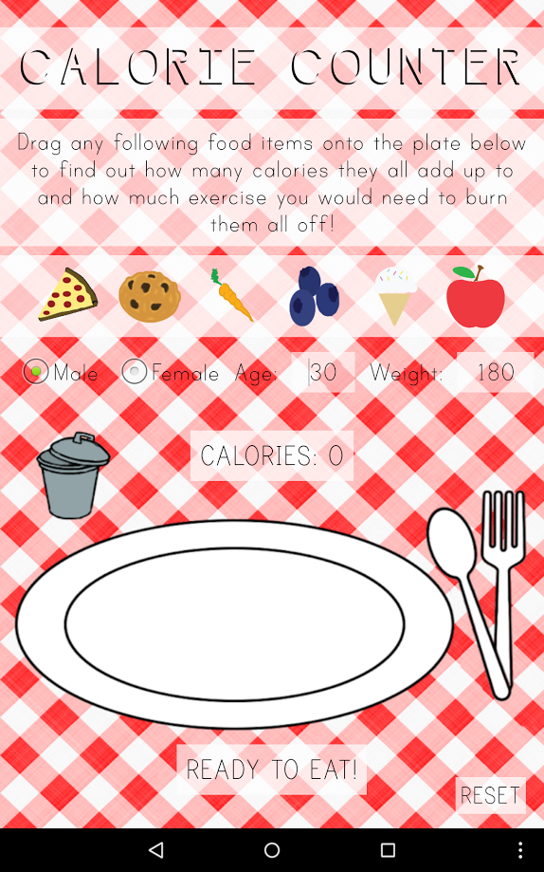
Calorie Counter
Our Calorie Counter page consists of:
Photoshop made graphics
Foods that can be dragged to the plate
Calorie counter and amount of time to burn those

Slide 10
Special Thanks to…
Florida Atlantic University
Dr. Shankar, Prof McAfee, Dr. Mitsova-Boneva
Santiago Aguerrevere, Demetrius Dukes, Alain Edwards
The Museum of Discovery and Science
Summer Scarlatelli and Joe Cytacki
United Way of Broward County

